Slide 1
Predicting Healthcare Costs
Ian Cook
George Achempim
Nick Mincucci

Slide 2
Background
In the US 1 in 10 or (33.2 million people) had no health insurance coverage in 2019
The population of uninsured US residents reduced to 25 million individuals in 2023
Policy measures such as the expansion of Medicaid, and enhanced subsidies under the Affordable Care Act have played a role in total insured
Racial and ethnic disparities in health insurance coverage persist throughout the US
For instance, 1 in 4 Hispanic adults aged 18–64 (24.8%) are uninsured as of 2023
Source: U.S. Uninsured Rate Drops by 26% Since 2019

Slide 3
Research Questions
Does smoking lead to higher insurance charges?
What are the effects of age on insurance charges?
Is region a reliable predictor for charges?
Do dependents linearly increase costs?
What attribute(s) have the most effect on insurance charges?

Slide 4
Dataset
US Health Insurance Dataset
https://www.kaggle.com/datasets/teertha/ushealthinsurancedataset
The dataset to be used contains over 1300 rows of insured data, where the Insurance charges are given against the following attributes of the insured: Age, Sex, BMI, Number of Children, Smoker and Region.

Slide 5
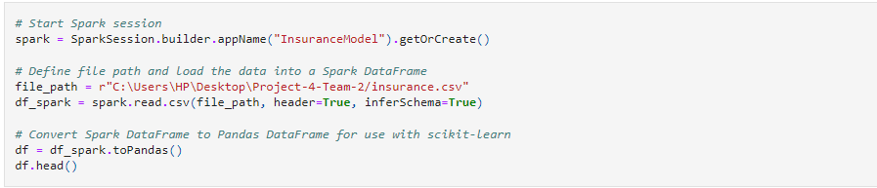
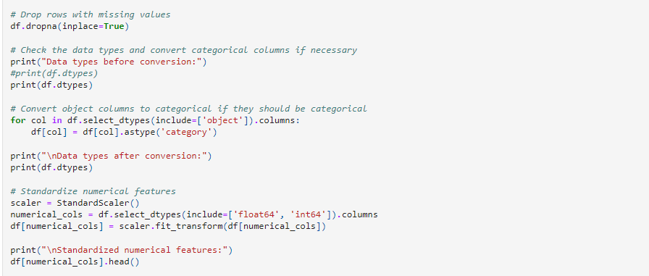
Data Cleaning and Standardization

Slide 6
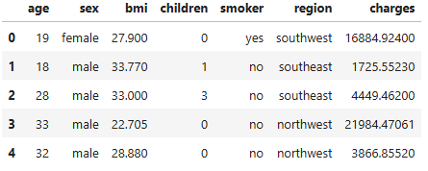
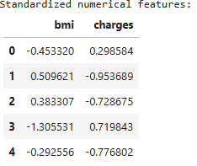
Standardization (cont.)
Pre- and post- standardization:

Slide 7
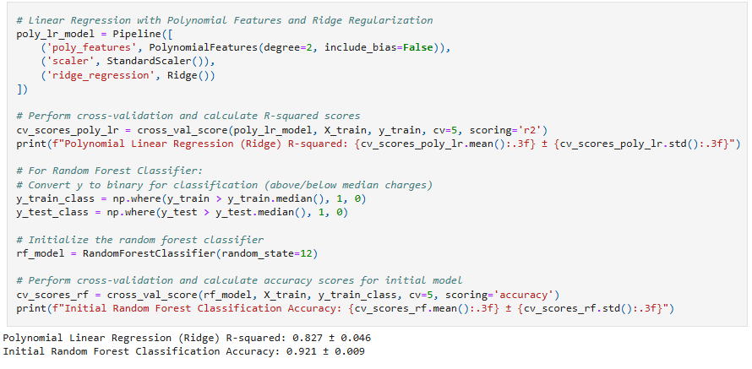
Initial Model

Slide 8
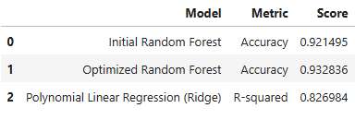
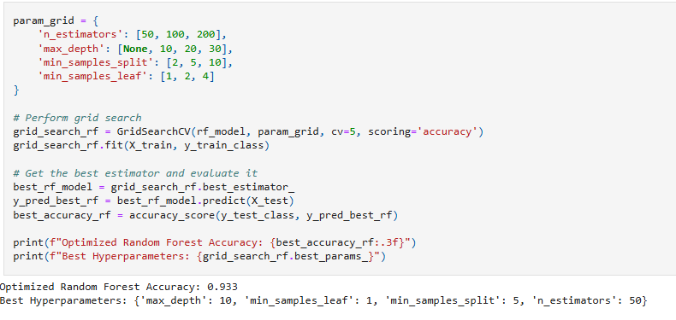
Optimized Model

Slide 9
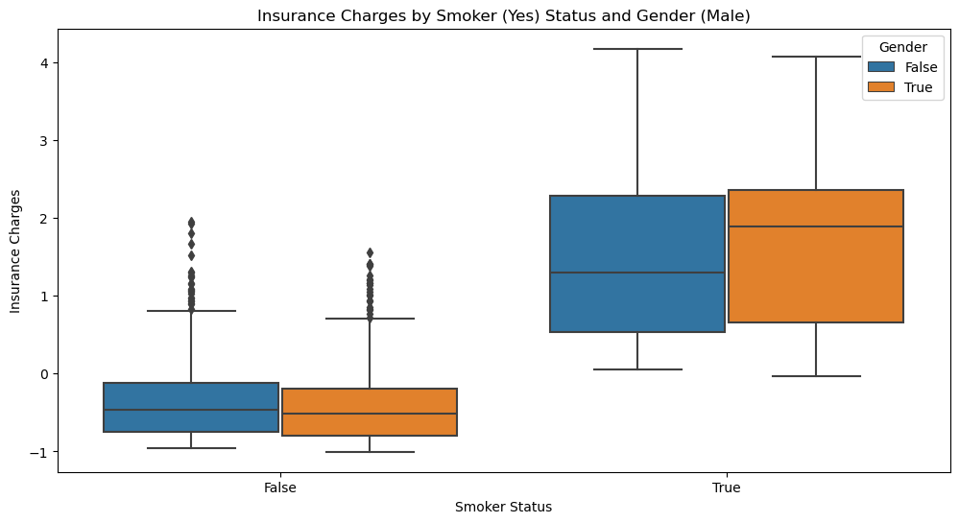
Effect of smoking on insurance charges
Smokers, on average, have higher insurance charges based solely on their status as smokers.

Slide 10
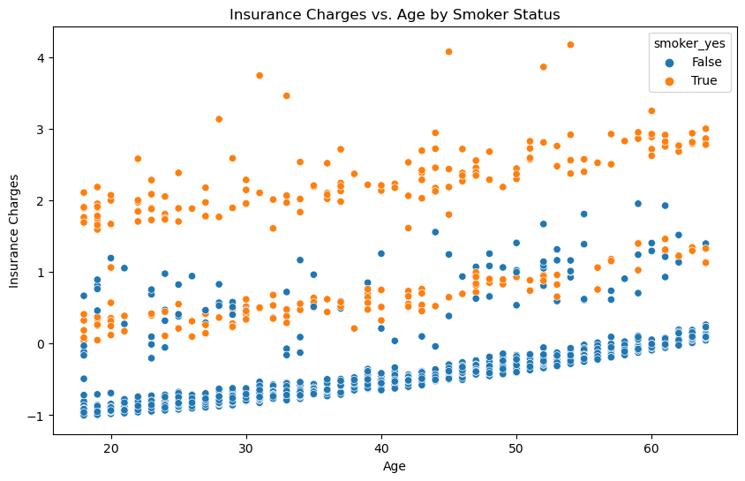
Effect of smoking and age on insurance charges
Shows that both smoking and age play a role in the increase of insurance charges

Slide 11
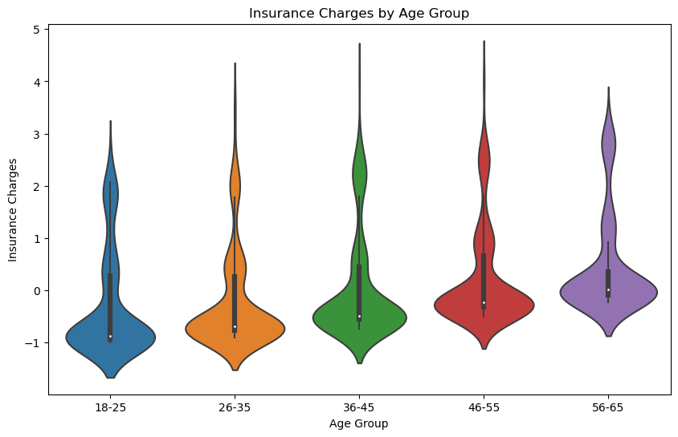
Effect of age on insurance charges
As age increases, so do insurance costs.
However, it seems that 56-65 has less extreme costs than most of the younger groups

Slide 12
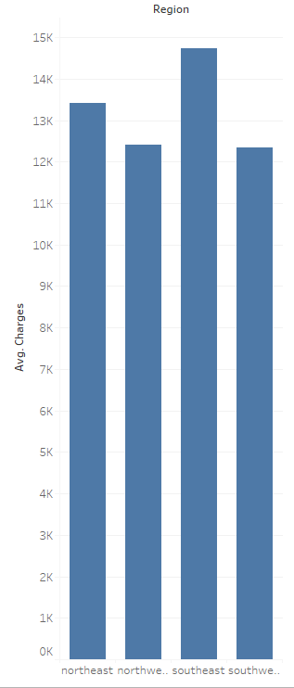
Impact of region on insurance charges
On average, the charges per customer are very minimally impacted by region.
This leads us to believe that region is not a great predictor of charges.

Slide 13
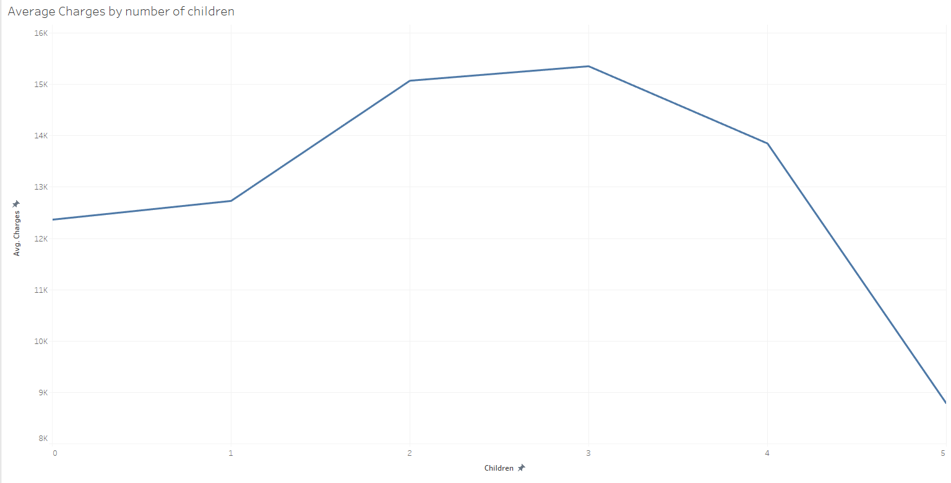
Dependants and insurance charges
Number of dependants does not seem to be a great predictor
One would expect each additional child to increase costs

Slide 14
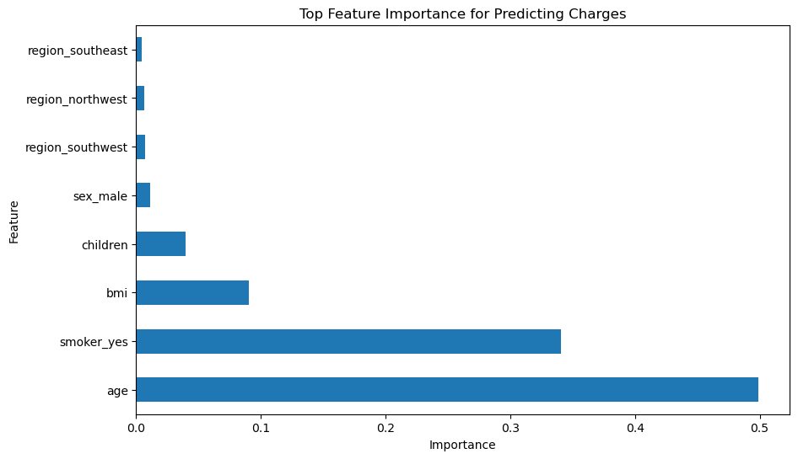
What attribute has the greatest impact on insurance charges?
Age and smoking status have the largest impact
Region does not seem to be a great predictor of insurance charges

Slide 15
Summary
Age and smoking status were the highest predictors
Region is not a reliable predictor of insurance charges
Children do not linearly impact costs of insurance

Slide 16
Limitations
Only one year of data was collected.
Not an abundance of data to analyze and to add to the modeling.
Healthcare costs is a multi-factor issue with contributing factors affecting the outcome such as pre-existing conditions, income level, education etc. This data only looked at a few contributing factors.
Potential bias in the regional and demographic representation.

